Slide 1




DEEP LEARNING CNN –BASED IDENTIFICATION OF PLANT NUTRIENT DEFICIENCY
TEAM MEMBERS
B.MALYADRI(21761A0573)
T.SAI(21761A05C8)
SK.NAGULU BI (21761A05C1)
PROJECT SUPERVISOR
DR.S.NAGARJUNA REDDY
ASSOCIATE PROFESSOR

Slide 2
CONTENTS
Abstract
Problem Statement
Introduction
Literature Review
Existing Work
Proposed Work
Proposed Architecture
Conclusion

Slide 3
ABSTRACT
This project presents a novel application of deep learning for the automated identification of plant nutrient deficiencies in agriculture. Utilizing convolutional neural networks (CNNs) and a curated dataset, our model achieves high accuracy in real-time detection of nutrient deficiencies across diverse environmental conditions. The system's interpretability is enhanced through saliency maps, providing insights into its decision-making process. Extensive testing on various crops demonstrates the model's robustness and generalizability, offering a valuable tool for farmers and agronomists. This research contributes to precision agriculture, facilitating timely interventions and promoting sustainability through increased crop productivity and resource efficiency.

Slide 4
PROBLEM STATEMENT
Nutrient deficiency in plants is a critical factor that significantly impacts agricultural productivity and food security. Identifying and addressing these deficiencies in a timely manner is crucial for optimizing crop yield and quality. Traditional methods of nutrient deficiency detection often rely on visual inspection by agricultural experts, which can be time-consuming, subjective, and prone to errors.

Slide 5
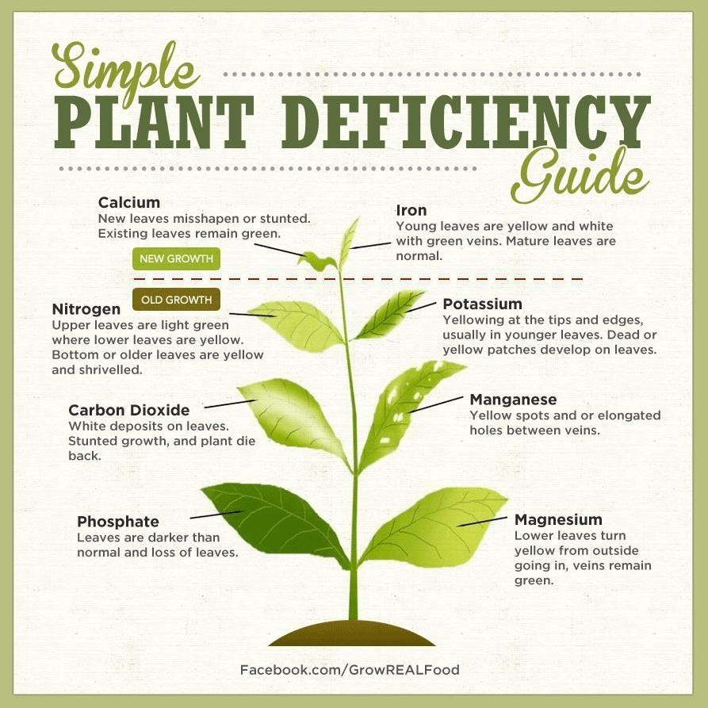
INTRODUCTION

Slide 6







LITERATURE REVIEW
TITLE | AUTHOR | YEAR OF PUBLISHED | MODEL | ACCURACY | DISADVANTAGES
Deep Learning For Identification Of Plantnutrient Deficiencies | M.Lavanya, M.Kalpana Devi, M.Sowmya Vani | 2022 | CNN | 91% | Less Number of Images – 125, Detects only Major Nutrient Deficiency in Plant.
Nutrient Deficiency Detection in Mobile Captured Guava plants using Light Weight Deep Convolutional Neural Networks | Sona Haris, N.Shobha Rani, Pushpa B.R | 2023 | CNN | 87% | Limited Dataset – 664 images, Class Imbalance – Majority of images belonging to the healthy class.

Slide 7
TITLE | AUTHOR | YEAR OF PUBLISHED | MODEL | ACCURACY | DISADVANTAGES
Deep Learning | K.C Nirasha | 2023 | YoLo v5, Mask R-CNN | YoLo v5 – 98% , Mask R-CNN- 92% | Limited Scope of Nutrient Deficiencies, Blurry Image Handling,
- Based Image | Jayasiri,
Analysis for | Sanjeevi
Detecting | Chandrasiri,
Nutrient | Shalini
Deficiencies of | Rupasinghe
Tomato Plants
Comparative | Bharath | 2023 | VGG16, DenseNet121, InceptionV3 Xception | VGG16 – 92% DenseNet121 – 92% InceptionV3 – 88% Xception – 93% | Risk of Disease, Risk of nutrient imbalances
Study on Rice | Anand,
Plant Nutrients | Nitish Kumar
Deficiency
Detection

Slide 8
TITLE | AUTHOR | YEAR OF PUBLISHED | MODEL | ACCURACY | DISADVANTAGES
Deep Learning | Supreetha S, | 2024 | ResNet 50 and SVM | 99.05% | Dependency on Data Augmentation – 1,156 to 4,963, Limited Dataset Scope - (N,P,K)
Techniques to | Premalathamma
Detect Nutrient | R,
Deficiency in
Rice Plants
Nutrient | Nurbaity Sabri, | 2023 | AlexNet | 90.85% | Limited Dataset – 90 images, Identifices only 3 types of Nutrient Deficiencies i.e., Nitrogen(N), Magnesium(Mg), Potassium(K)
Deficiency | Zuhri Arafah
Classification | Zulkifli
Using AlexNet
Architecture

Slide 9

TITLE | AUTHOR | YEAR OF PUBLISHED | MODEL | ACCURACY | DISADVANTAGES
Analysing the | Junior | 2024 | Inception-V3 CNN, VGG-16 | Inception-V3 93% | Data Dependency, Trade-Off Between Accuracy and Interpretability
Performance and | Mkhatshwa,
Interpretability of | Tatenda
CNN-Based | Kavu
Architectures for
Plant Nutrient
Deficiency
Identification
Exploiting Pre- | Zeki Gul, | 2023 | VGG16, DenseNet201, ResNet101V2, | VGG16- 93.8% DenseNet-90% ResNet-86.37% | Dependency on Quality of Pre-Trained Models, Implementation Complexity,
Trained | Sebnem Bora
Convolutional
Neural Networks for
the Detection of
Nutrient
Deficiencies in
Hydroponic Basil

Slide 10
TITLE | AUTHOR | YEAR OF PUBLISHED | MODEL | ACCURACY | DISADVANTAGES
Nutrient | S.Adinarayana, | 2023 | DenseNet,VGG, MobileNet,CNN | MobileNet-98% | Complexity and High Performance Requirements, Data Dependency, Execution Complexity
Deficiency | S.Hrushikesava
Detection | Raju
Using a
Mobile Net: An AI-based Solution
Detection of | Jai | 2023 | CNN | 92% | High Computational Requirements, Data Quality and Diversity, Overfitting Risks.
healthy and | Vardhan,
diseased crops in | Kothapalli
drone captured | Sai Swetha
images using Deep
Learning

Slide 11
Existing Work
The existing work utilizes Convolutional Neural Networks (CNNs) for the diagnosis of plant nutrient deficiencies through image analysis. This method focuses on accurately classifying a single nutrient deficiency in plant leaves. The process involves capturing high-resolution images, preprocessing them to isolate leaf pixels, and dividing the images into smaller blocks for detailed analysis. A pre-trained and fine-tuned CNN model is used to extract features from these blocks and detect signs of a specific nutritional deficiency. The primary aim is to determine whether a block of leaf pixels exhibits symptoms of one nutrient deficiency, providing an accurate classification to guide appropriate nutritional interventions.

Slide 12
Proposed Work
The proposed work builds upon the existing approach by incorporating a multi-label classification system capable of detecting multiple nutrient deficiencies within a single plant simultaneously. This method begins with capturing high-resolution images under consistent lighting conditions, followed by normalizing and segmenting the images to focus on leaf pixels. The images are then divided into smaller blocks, and a fine-tuned CNN model extracts relevant features. Unlike the single-label approach, the multi-label classification system identifies various combinations of deficiencies and assesses their severity. Based on the severity and type of deficiencies detected, the system recommends specific treatment plans, detailing application methods and timing to ensure effective intervention. This comprehensive approach aims to improve diagnostic accuracy, offer precise treatment recommendations, and optimize resource use, thereby enhancing overall plant health.

Slide 13
Proposed Architecture
Plant Village
Dataset
Data Splitting
Training Set
Testing Set
Model Training
Model Testing
MobileNet V1
Evaluation
Comparison
Conclusion

Slide 14
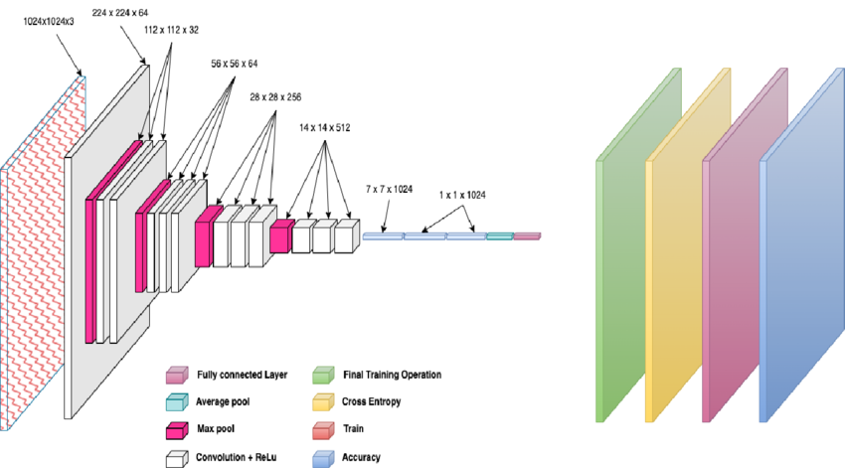
MobileNet V1 Architecture

Slide 15
CONCLUSION
In conclusion,
the plant nutrient deficiencies detection project employing
Neural Networks (CNNs) represents a pivotal advancement in
Convolutional
precision agriculture, with profound implications for crop management and global food security. Through the integration of deep learning technology, the project not only addresses key challenges in nutrient deficiency identification but also paves the way for transformative changes in modern farming practices. This can be utilized in future to classify the types of different Deficiencies easily that which can tend to easy to Predicated the Nutrient for plant in early stages and can take the initial curing of plants and take measures to not affect other plants.

Slide 16
THANK Y0U

